Slide 1
CS104 Sprint Project Presentation
By: Jason Lyons, Chloe Joyce, and Reese Griffin

Slide 2
Roles for our group:
Jason: Complete system design documents and Gantt Charts
Chloe: Complete system design documents and Flowcharts
Reese: develop algorithms and code to program the robots

Slide 3
Challenges faced:
Hard getting in touch at times with group members
Not knowing exact measurements and layouts for each sprint when programming and testing the robot
Not all having access to the robot

Slide 4
What we have learned about software engineering:
Learned how to program and create block code
Learned what a proper system design document, flowchart, and gantt chart should all look like
Learned how to properly test our code and recognize what’s going wrong

Slide 5
What we would’ve done differently:
Prioritized our time better
Followed Professor Eckert’s guidelines a bit more for Sprint’s 1 and 2
Work split up more evenly
As a group, possibly connecting over FaceTime or Zoom to collaborate

Slide 6
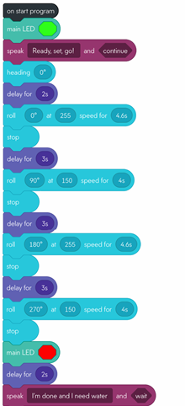
Block Code for Sprint 1:

Slide 7
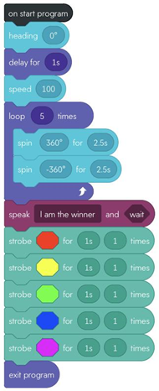
Block Code for Sprint 2:

Slide 8
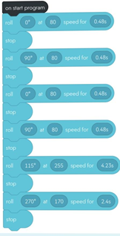
Block Code for Sprint 3:

Slide 9
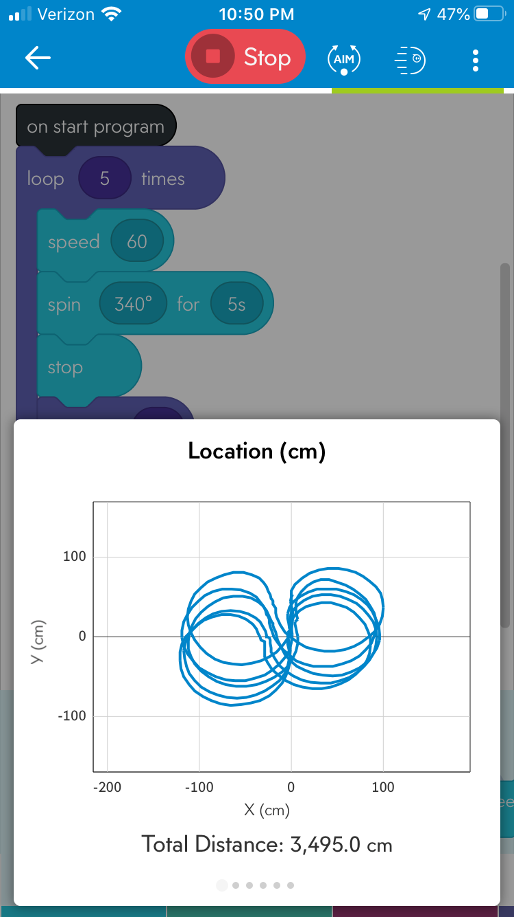
Figure 8 path

